Slide 1
Advanced Angular
Deployment
Lecture 10
By James(Jin) Wang
11/15/2021

Slide 2
Outline
Optimize your apps for deployment
Build deployable packages
Work with different environments
Lint your code
Deploy your apps to Github Pages, Firebase and Heroku

Slide 3
Optimization Techniques
  Techniques:
  Minification
  Uglification
  Bundling
  Dead code elimination
  Ahead-of-time (AOT) compilation

Slide 4
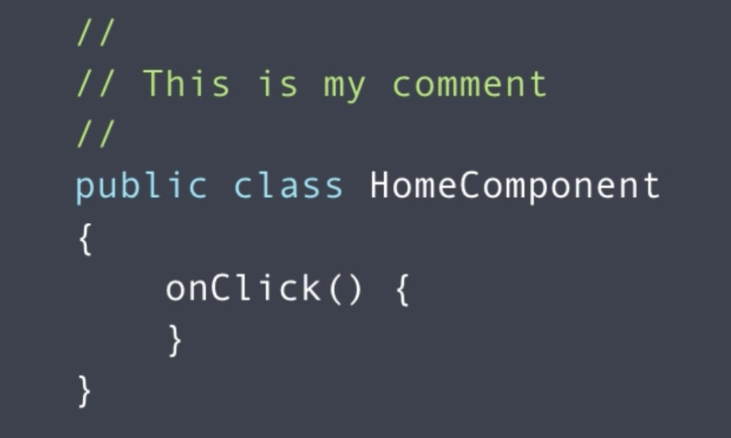

Optimization Techniques
  Minification:

Slide 5
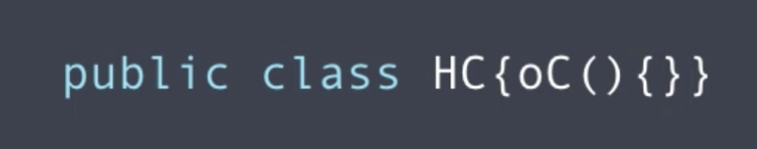
Optimization Techniques
  Uglification:

Slide 6
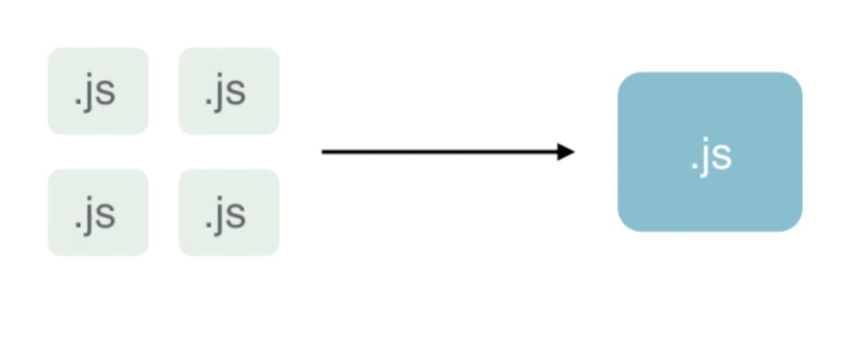
Optimization Techniques
  Bundling:
  ng build -prod

Slide 7
Optimization Techniques
  JIT vs AOT Compilation:
  Just-in-time Compilation:
  Inefficient for production
  Happens for every user
  More components, slower
  We have to ship Angular compiler

Slide 8
Optimization Techniques
  JIT vs AOT Compilation:
  Ahead-of-time Compilation:
  Faster startup
  Smaller bundle size
  Catch template errors earlier
  Better security

Slide 9
Angular Compiler
  Angular Compiler:
  in package.json:
  "@angular/compiler-cli": "^4.0.0",
  node_modules/.bin/ngc

Slide 10
Angular Compiler
  Build Apps with Angular CLI:
  ng build --prod

Slide 11
Environments
  Environment:
  add: (environment.ts, prod.ts)
  navBarBackgroundColor: ‘blue’
  add: (navbar.component.ts)
  backgroundColor = environment.navBarBackgroundColor;
  add: (navbar.component.html)
  <nav [style.backgroundColor]="backgroundColor"
  ng serve --env=prod and ng serve

Slide 12
Environments
  Add Custom Environment:
  add: (environment.test.ts)
  navBarBackgroundColor: ‘red’
  add: (angular-cli.json)
  "test": "environments/environment.test.ts",
  ng serve --env=test

Slide 13
LINT
  Linting with Angular CLI:
  in: (package.json)
  "tslint": "~5.3.2",
  in: (tslint.json)
  "quotemark": [
  true,
  "single"
  ],
  ng lint
  ng lint --fix

Slide 14
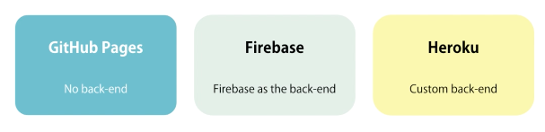
Deployment
  Other Deployment Options:

Slide 15

Deployment
  Deploy to Github pages:
  pages.github.com
  sudo npm i -g angular-cli-ghpages
  ng build --prod --base-href=“https://username.github.io/repo/”
  sudo ngh

Slide 16
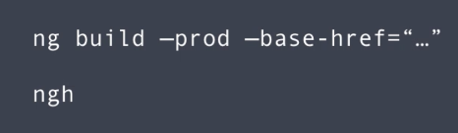
Deployment
  Deploy to Github pages:
  Steps:

Slide 17
Deployment
  Deploy to Firebase:
  Provided by Google
  Used for building backend of web/mobile apps
  Real-time, fast and scalable database
  Cloud messaging
  Hosting

Slide 18
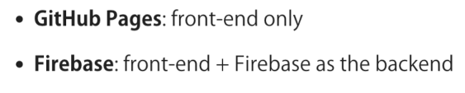
Deployment
  Firebase or Github:

Slide 19
Deployment
  Deploy to Firebase:
  console.firebase.google.com
  sudo npm i -g firebase-tools
  firebase login
  firebase init
  change: firebase.json
  "public": "dist",
  ng build --prod
  firebase deploy

Slide 20

Deployment
  Deploy to Heroku:

Slide 21
Deployment
  Deploy to Heroku:
  heroku --verson
  heroku login
  npm i express --save

Slide 22
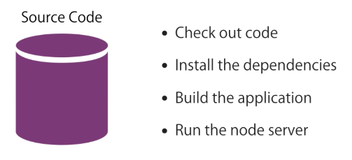
Deployment
  Deploy to Heroku:
  heroku create heroku-followers-app
  heroku open
  git push heroku master

Slide 23
Summary

